Slide 1
A Two DoF Self Adaptive Bionic Ankle
Dream Aero
Lucas Chen & Justin Guo

Slide 2
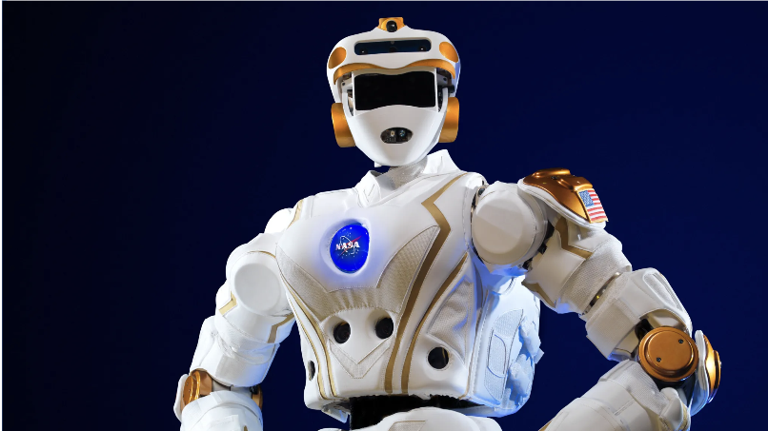
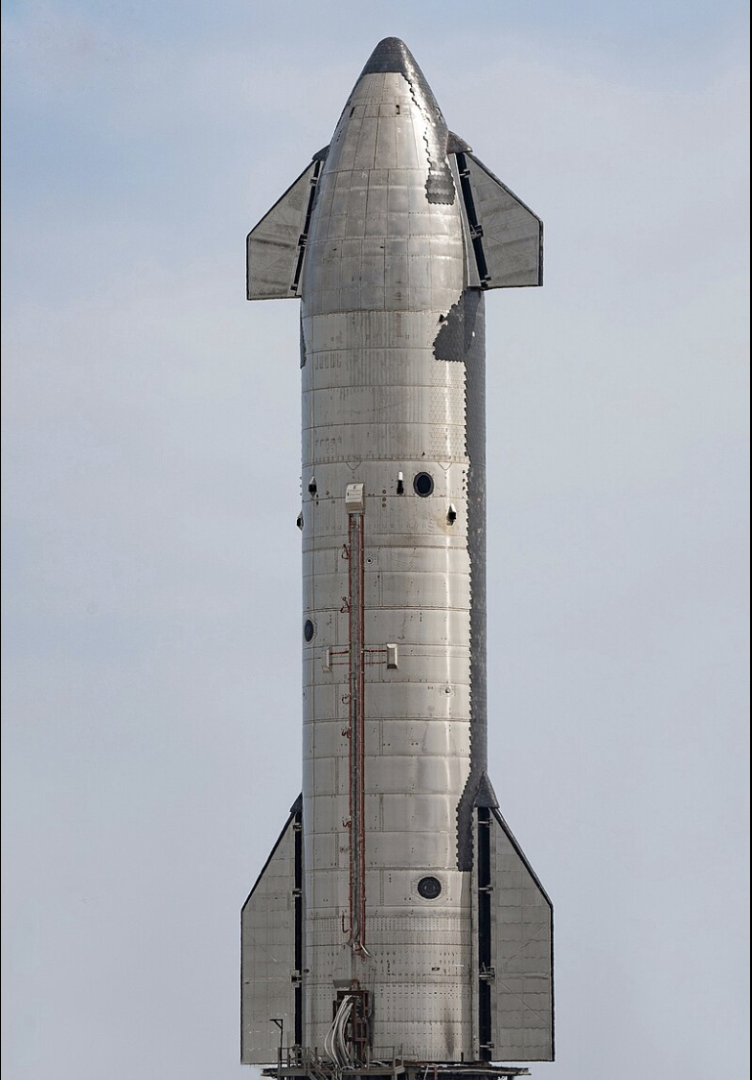
Space Exploration
Everyone is going for space exploration:
Elon Musk founded SpaceX, aiming for a migration to Mars
NASA is planning on Artemis III, sending human to the moon
NASA is planning on Valkriye, a humaniod robot ready to go on Space
Why? Earth resources are depleting: Overpopulation is a problem
We need to explore Space, in search of resources and living space

Slide 3
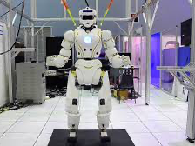
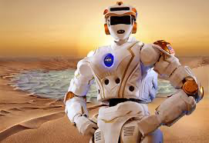
Background Signficance and Proposal
In Space, we are not going to build flat roads during our exploration. We need robots that focuses on movement ability, including the ability to move through rough terrain and great cliffs. These robots are taking the role to going on a mission to Mars.
The machinery need to stabilize and adapt to the unknown surroundings.
Proposal: A good leg, or more specific, a good ankle will help the machinery to traverse better in space environments.

Slide 4
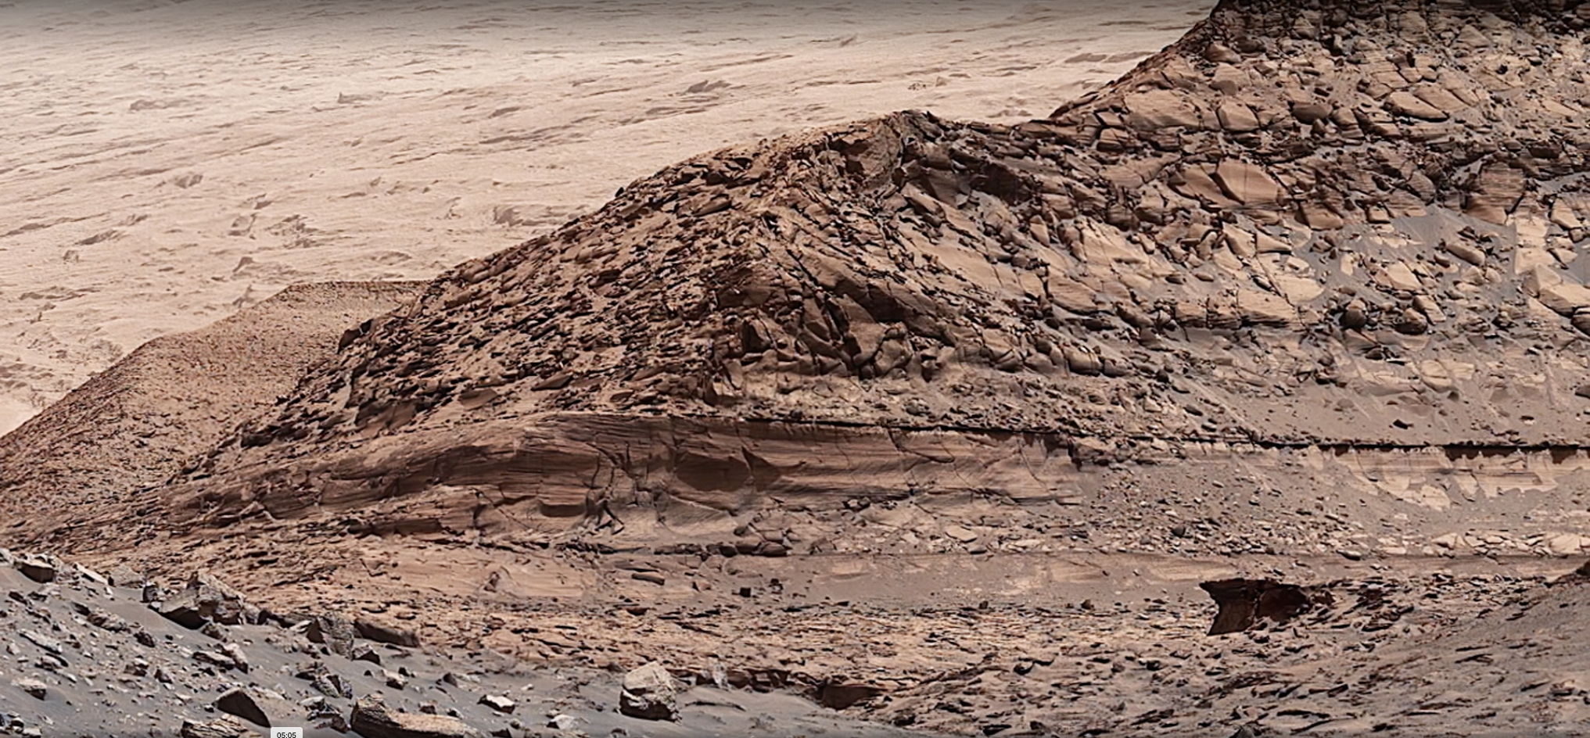
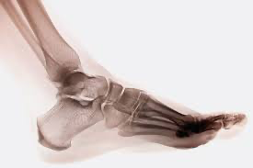
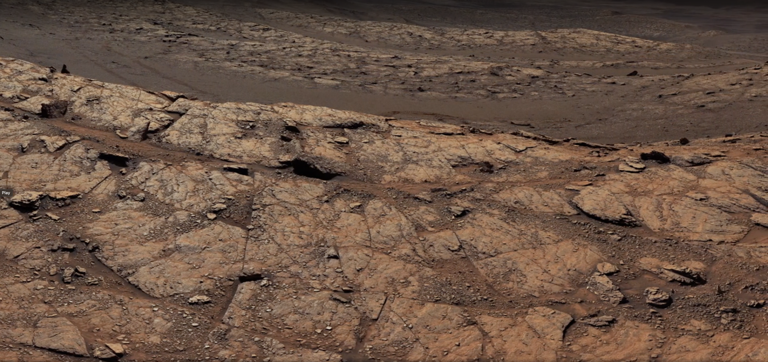
Why Human Ankle?
We need an ankle, allowing 2 dimensional movement, that have the ability to travel in all kinds of terrain.
Human ankle:
exceled at self adapting to different environment,
is stable in these different environments,
and is energy efficent

Slide 5
Innovation and Challenges
Which will include:
an additional motor to control not only the leg's dorsiflexion and plantar flexion, but also inversion and eversion movement of an ankle in human leg
a self adaptive program for it to aid movement
the usage of motor system to simulate the muscles in human leg
the usage of springs to simulate the shock absorption mechanics in human leg
Challenges:
1. Mechanical Structure: How are the two motors in the ankle goint to be placed?
2. Reaction to the Ground: How does the bionic ankle sense the ground?
3. Connection: How should the motors and the sensors collborate?

Slide 6
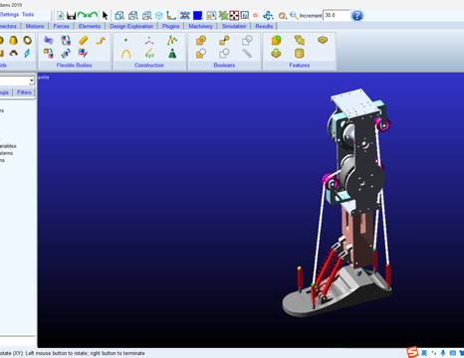
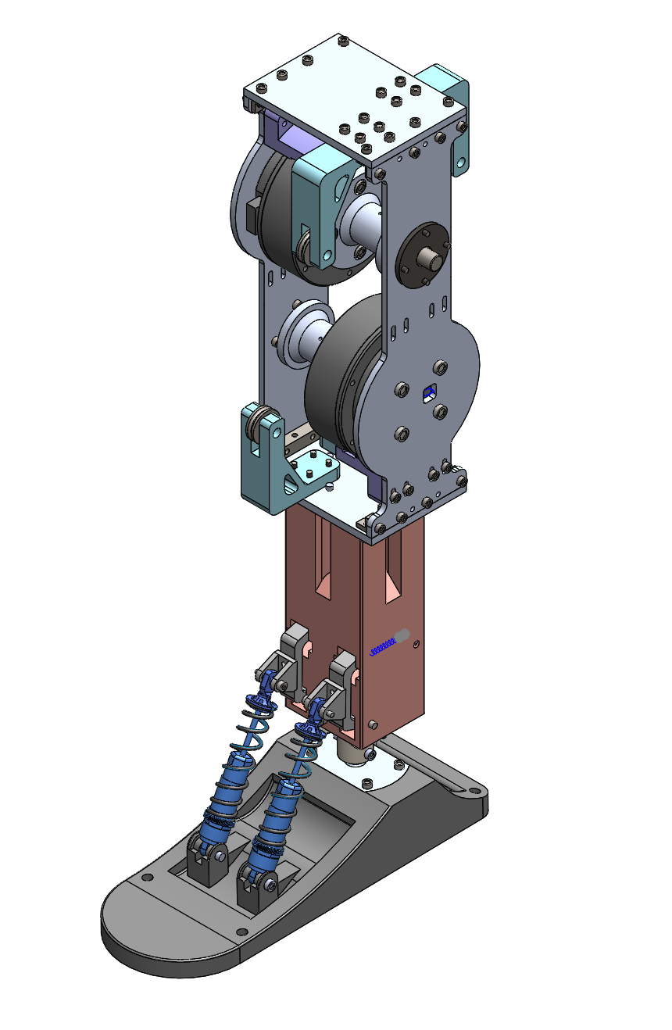
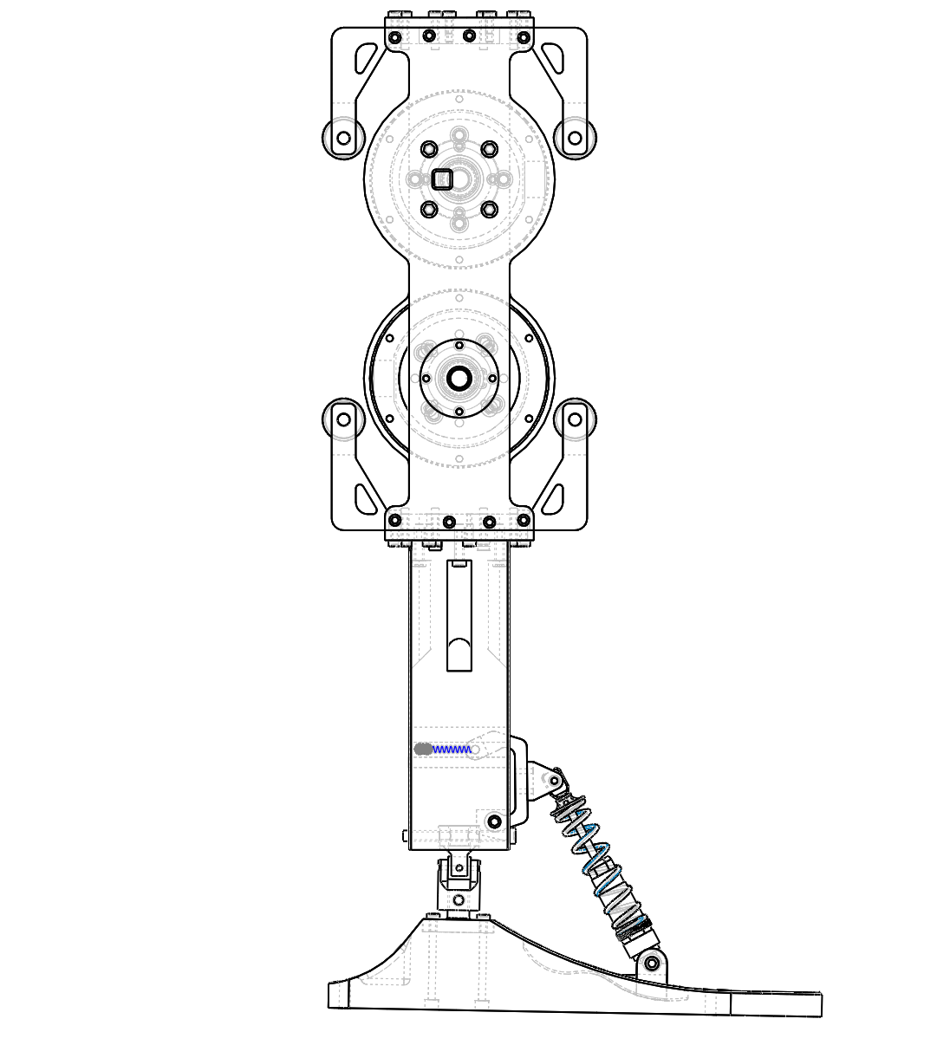
Structural Design
Use Solidworks to plan out the whole structure and record the parts needed to build the whole structure.
Motor-string system to balance the weight of the object
Usage of springs to absorb shock
3.17 – 3.31

Slide 7
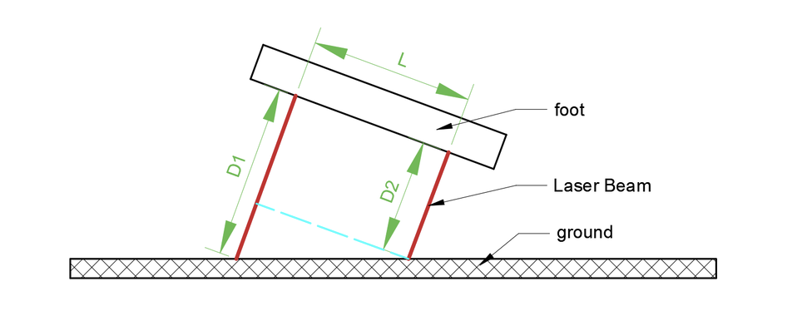
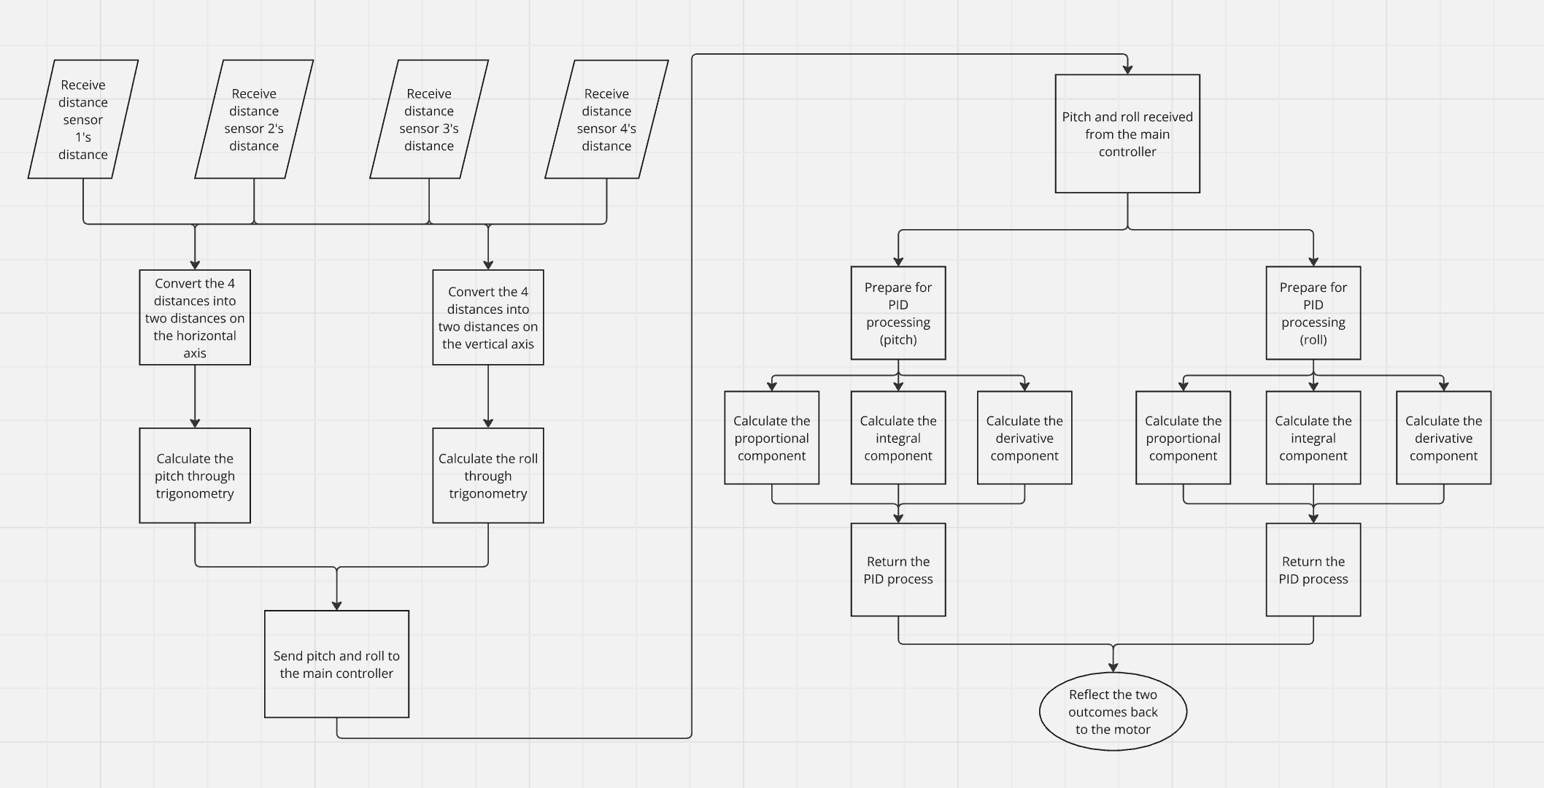
Software Programming
The laser distance sensors is implemented with the right diagram.
The PID controller will self-adjust the two angles, roll and pitch to quickly and efficiently adjust the angle of the foot, making it parallel to the ground.

Slide 8
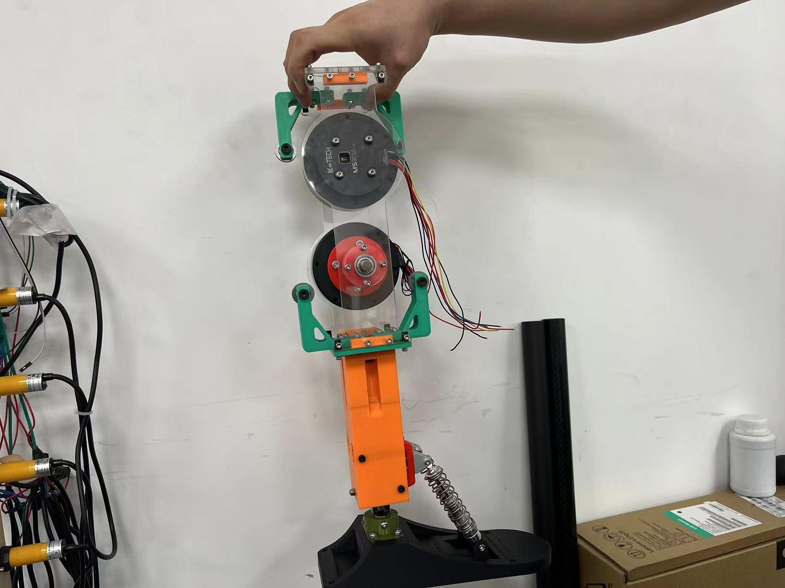
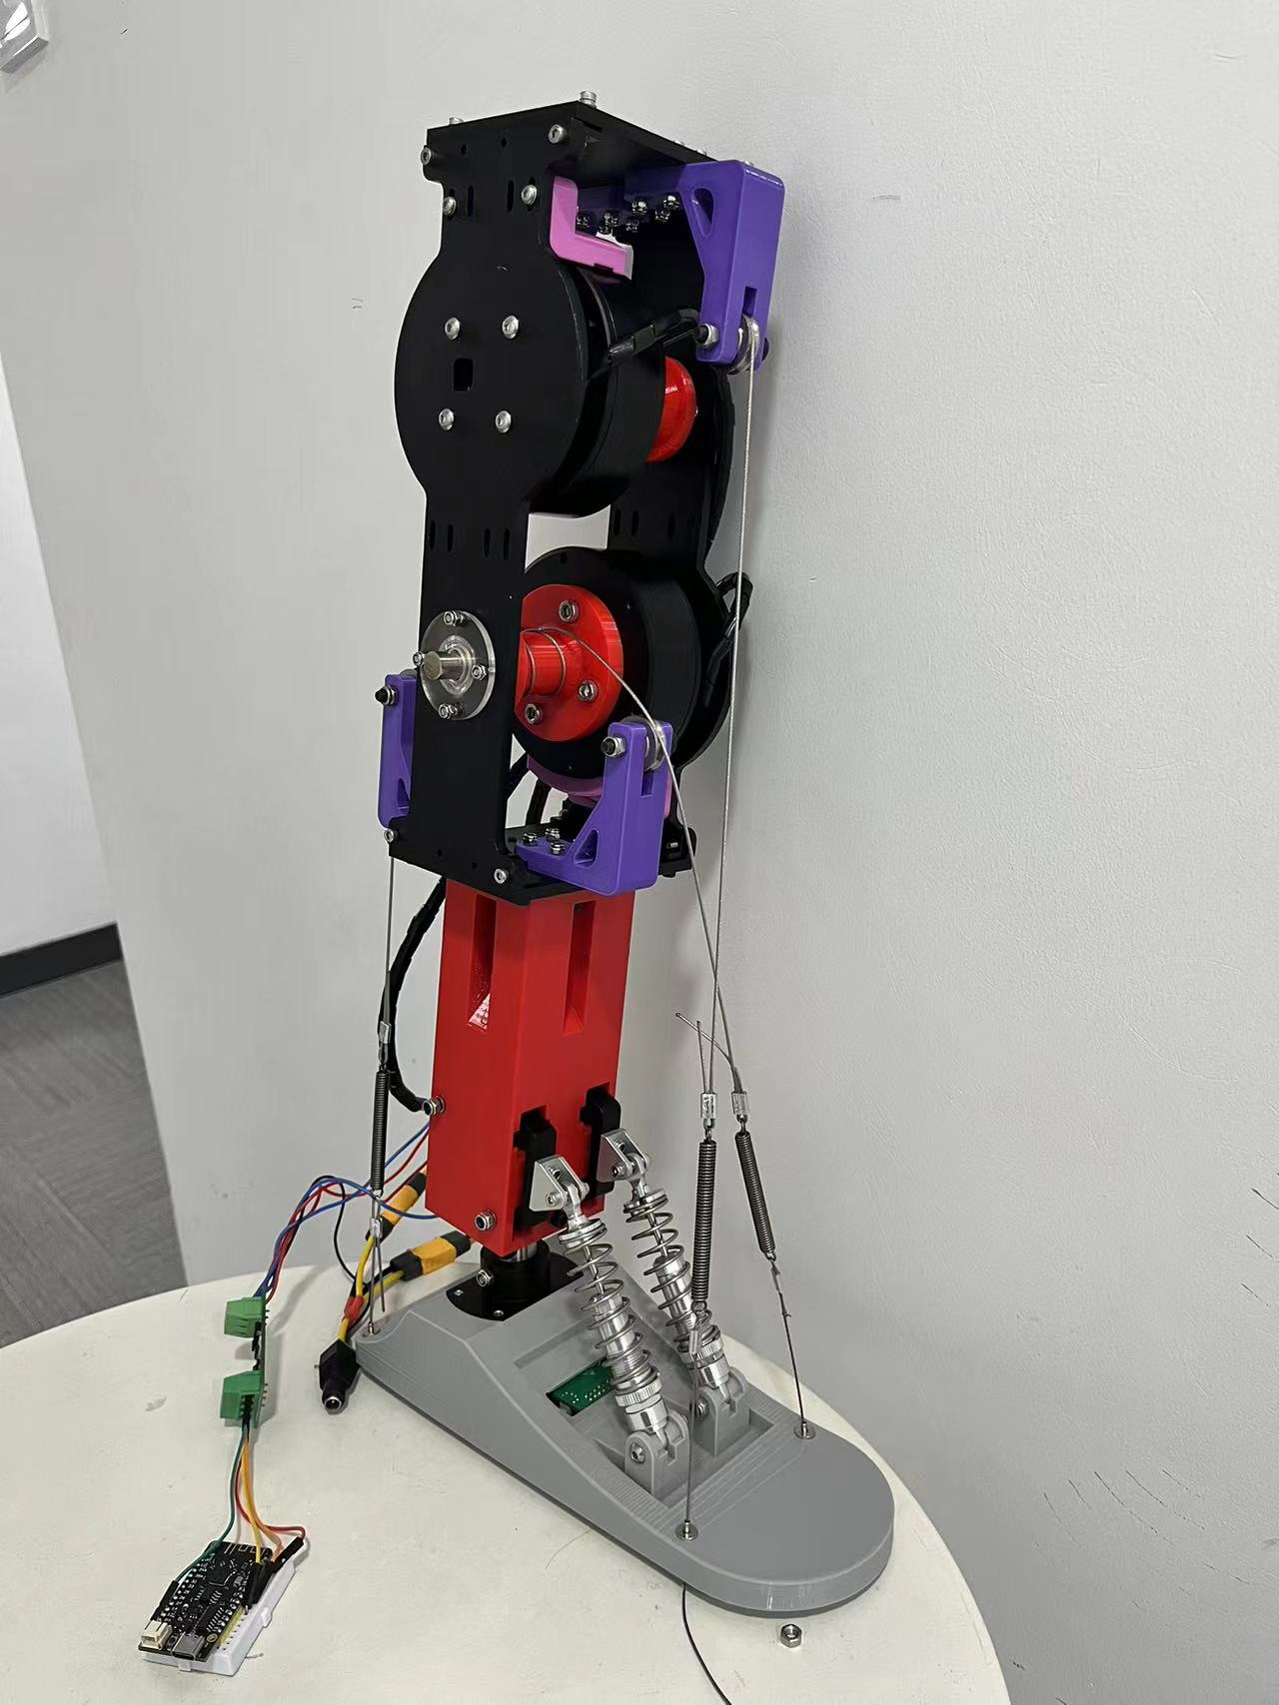
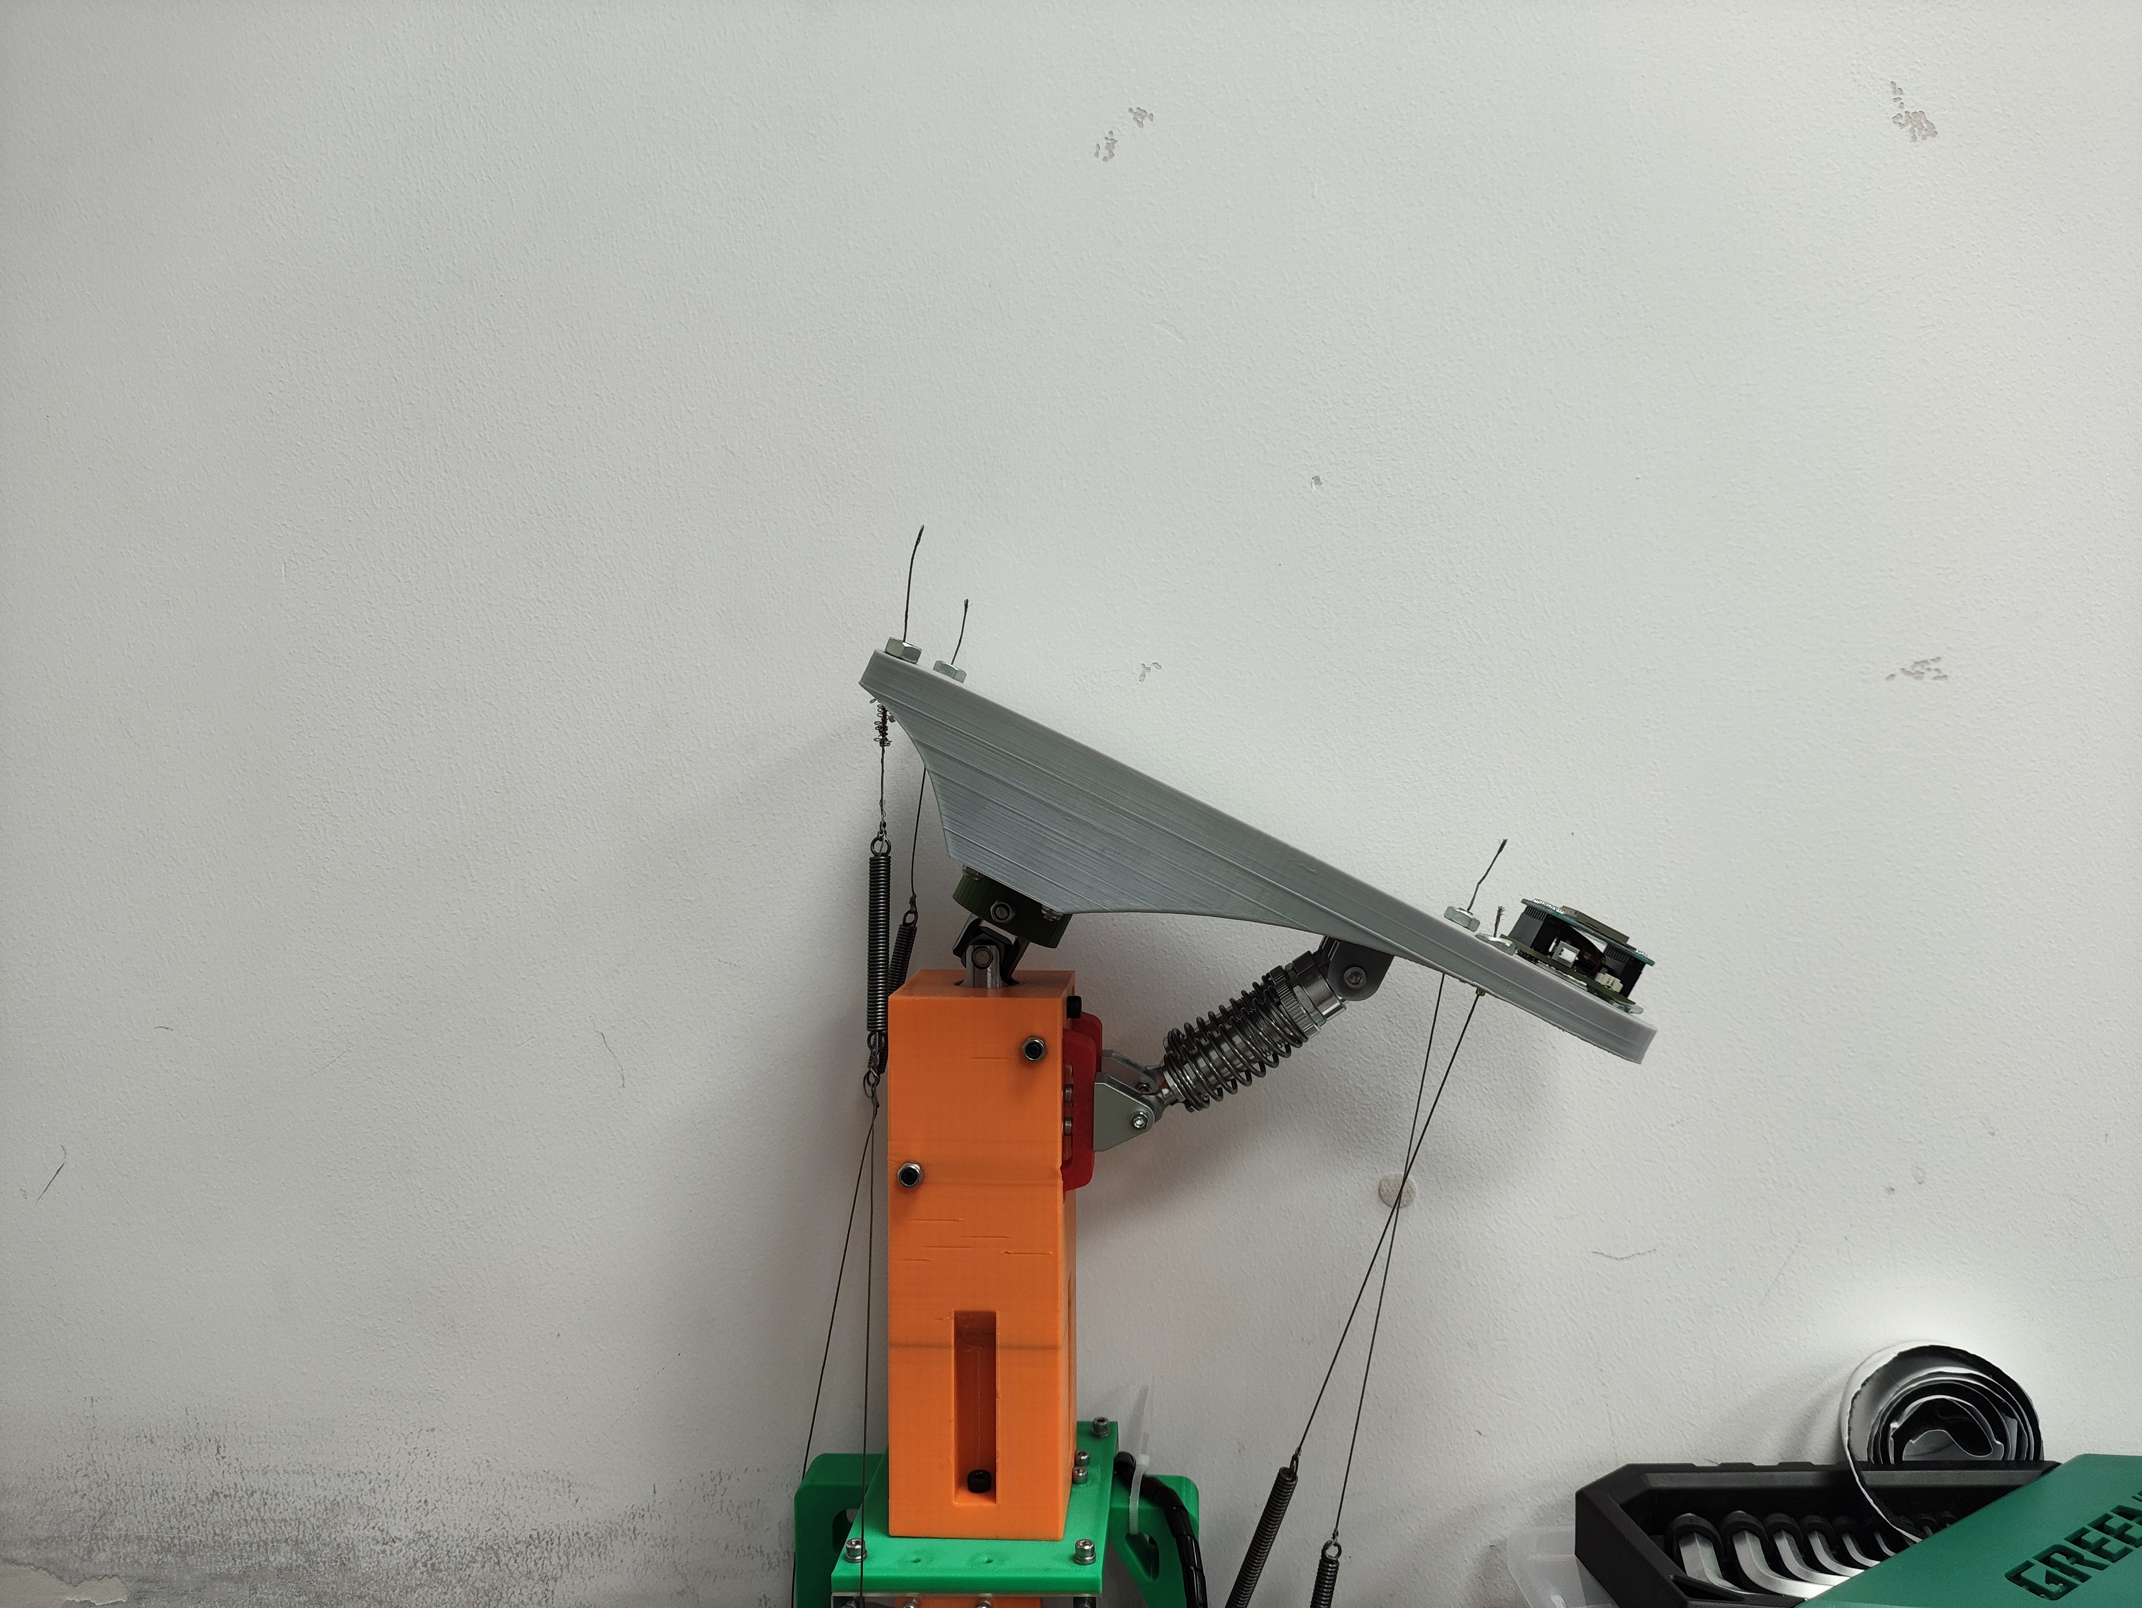
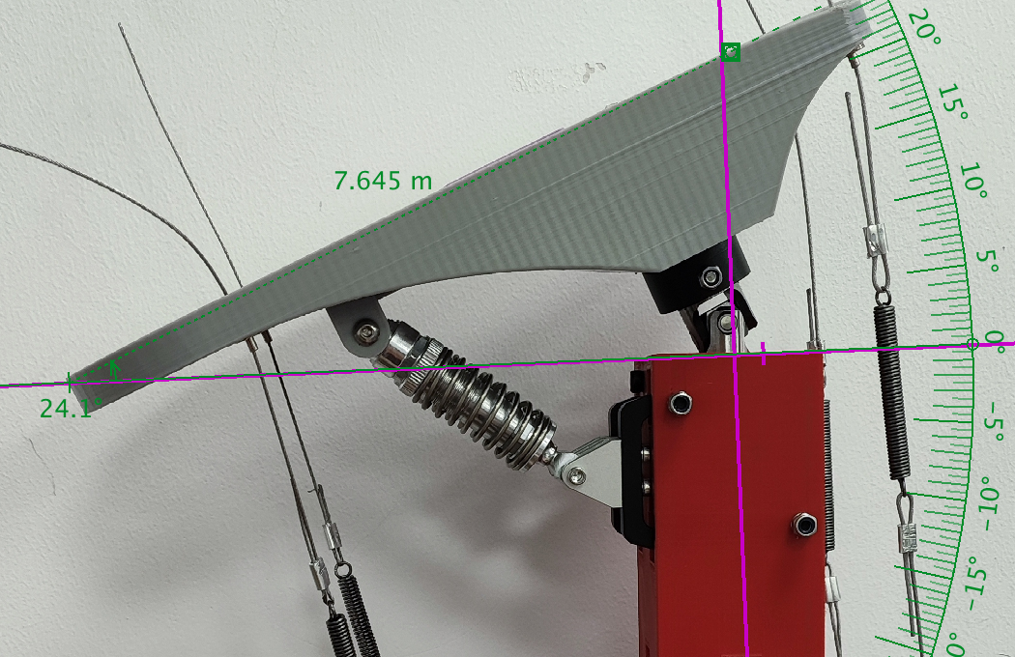
First and Second Model
We started on the first prototype of the bionic ankle to work on the code.
4.5 – 6.24
3D printed materials cannot withstand the force exerted by the motors, so aluminium boards are needed.
A damping is needed to use up the additional motors force.
6.24 - now

Slide 9
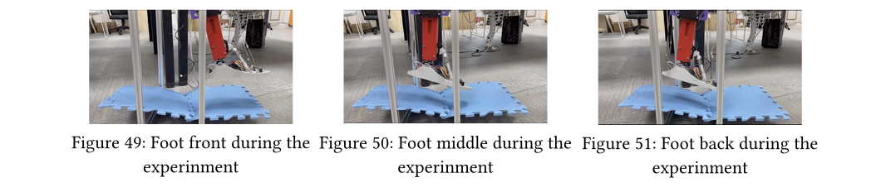
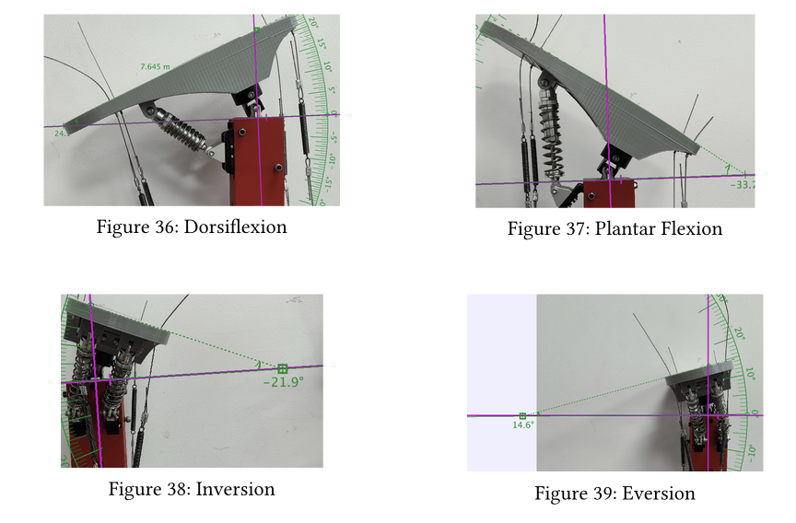
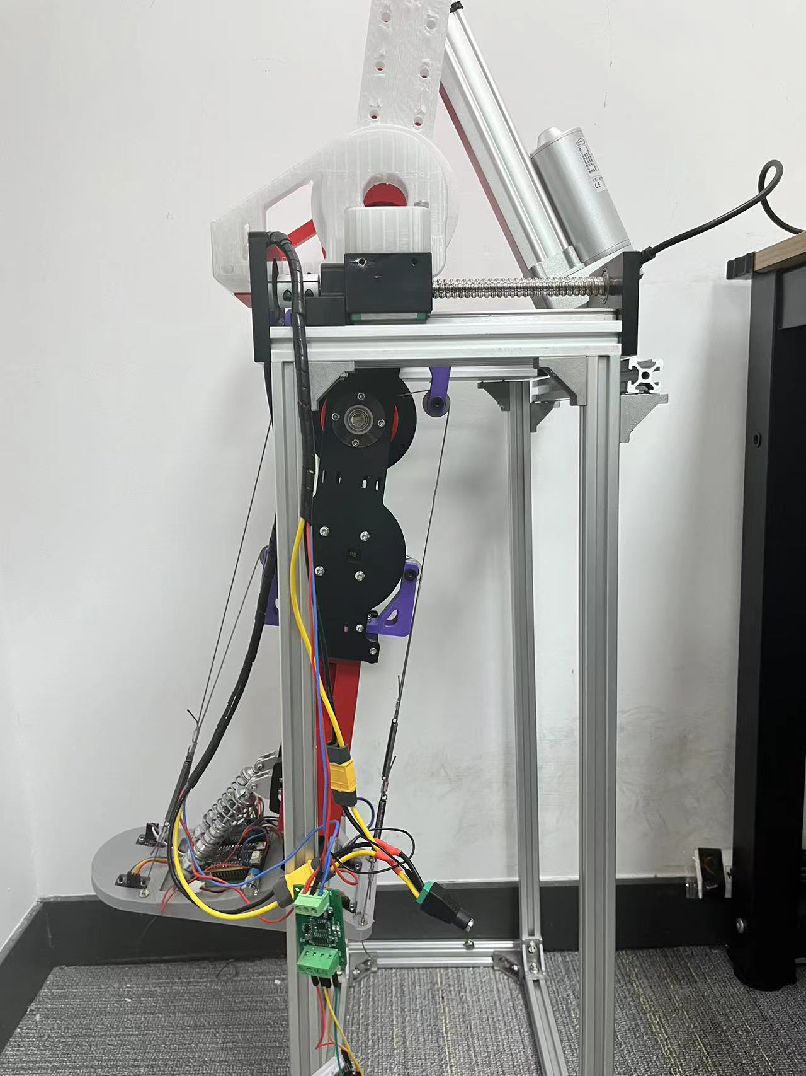
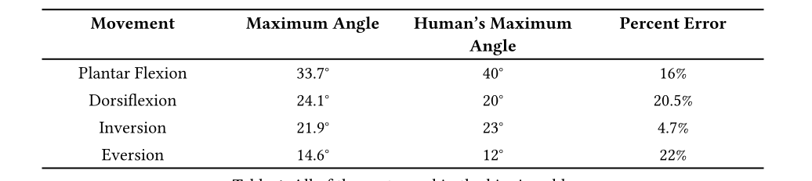
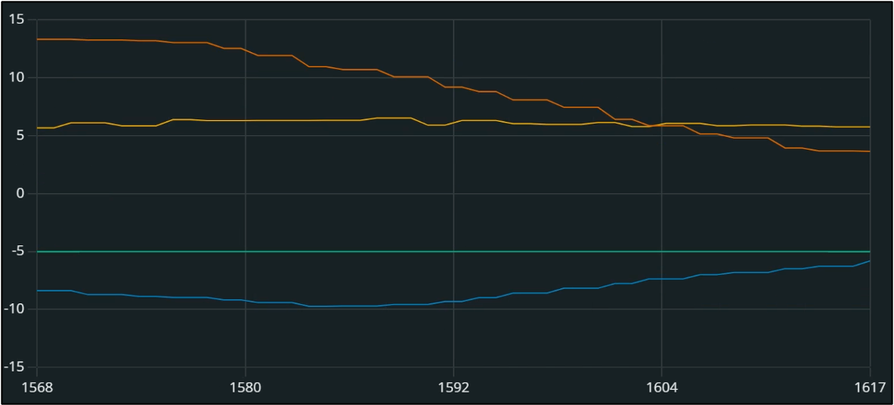
Maximum Angle and Self-adaptive Experiments

Slide 10
Future Improvements
In this prototype, we have sucessfully demonstarted the basic functions of such 2 dof bionic ankle. Of course, there is still nessary steps for it to be used on space exploration such as Mars.
Future experiments on low gravity environments for examination of impactagainist ground (springs)
Experiment on different foot types for different situations (such as for stability on rough ground)
Coordination of ankle with legs and upper body

Slide 11

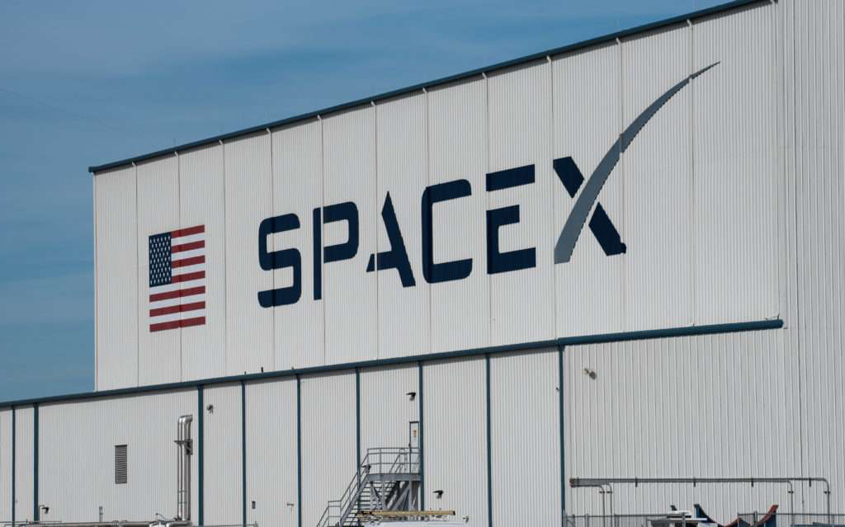
Market and Target Customers
Public Space Agencies: NASA, ESA, and JAXA...
Advanced Mobility, Space Missions
Private Space Exploration Companies: SpaceX, Blue Origin...
Low costs, lightweight
Robotics Manufacturers: Boston dynamic, Agility Robotics
Innovative, Commercial Viability
Notes:
Who are they, what are their demands? How are you planning on using your product to statisfy their demands. Therefore, what could be your business models?

Slide 12
Financial modeling
Materials | Price
Two Motors and Spring System | ￥1400
Aluminum Framework | ￥700
Laser Sensors | ￥100
Coil, Springs, Wires, Other 3d printed Material | ￥200
Total | ￥2300
Manufaturing and Managements | Price
Production Equipment | ￥160,000-180,000
Supplier and Logistics | ￥40,000-50,000
Marketing and Branding | ￥60,000-80,000
Labor Costs | ￥180,000-210,000
Rent | ￥150,000-170,000
Total | ￥590,000-690,000
Research and Development | Price
Software and Control System | ￥40,000-50,000
Experiment + Prototypes | ￥50,000-80,000
Optimizing material | ￥20,000-30,000 (variable)
Total | ￥110,000-160,000

Slide 13
Business Model
Model Types | Production Cost | Price | Repair costs (Minor fix– Major Overhaul)
Basic Model (3-D material, low cost sensors) | ￥2,300 | ￥11,000 | ￥1,000-6,500
Standard Model (Better Material and Sensors) | ￥5,000 | ￥18,000 | ￥1,500-9,000
High-End Model (Advanced material, actuator, and sensor) | ￥8,500 | ￥25,000 | ￥2,000-12,000
Licensing | Upfront Payment | Royalty
Single-Use License | ￥100,000 | 0-5%
Multi-Use License | ￥200,000-300,000 | 5-7%
Exclusive License (Time Dependent) | ￥500,000-1,000,000+ | 7-10%

Slide 14
SWOT ANALYSIS
STRENGTH Two DoF Self Adaptive Program for rough Terrains Able to absorb shock | WEAKNESS Heavy Motor Unstable PID Control system Small degree of freedom Limited Market
OPPORTUNITIES Experiments in different gravity Rising demand in Space Exploration Partnerships with Space companies / Agencies | THREATS Competition from other robot designs Funding and Market Uncertainty

Slide 15

Future Business Plans
1. Branding & Thought Leadership
Present at major space and robotics conferences, such as IAC (International Astronautical Congress), IEEE Robotics Conferences, and CES.
2. Pilot Programs & Early Adoption
Offer limited prototypes to key stakeholders for real-world testing on robotic systems in analog space missions.
Create subscription-based licensing models for research institutions, allowing early adopters to use and refine the technology.
Product Line Expansion: Developing specialized models to meet different customer needs.
High-Performance Model: Optimized for space exploration with durable, lightweight materials.
Cost-Effective Model: Affordable version for research and commercial use with standardized design.
Sustainable Model: Made with eco-friendly materials and low-emission manufacturing.

Slide 16
Future Business Plans
Branding & Thought Leadership Present at major conferences such as IAC (International Astronautical Congress), IEEE Robotics Conferences, and CES to showcase our technology and establish credibility.
Pilot Programs & Early Adoption Offer limited prototypes to key stakeholders for real-world testing in analog space missions. Develop a subscription-based licensing model for research institutions, allowing early adopters to use and refine the technology.
Product Line Expansion
High-Performance Model: Built with durable, lightweight materials for space exploration.
Cost-Effective Model: Standardized design for affordability in research and commercial use.
Sustainable Model: Uses eco-friendly materials and low-emission manufacturing.

